Slide 1
Reading Timelines
A Nonfiction Reading Skill

Slide 2
Overview
Much like a flow map, a timeline will show a sequence of events.

Slide 3
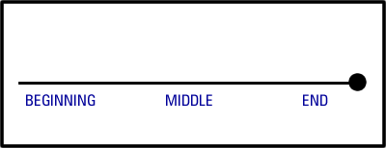
PRACTICE
A timeline can be used to sequence any events, even a story. It can be as simple as: beginning, middle, end.

Slide 4
PRACTICE
Read the following passage:
Victor likes playing baseball. His team is called “The Rockets.” Last weekend, his team played in the park. Victor led The Rockets. He assigned batting order. Though The Rockets won, it wasn’t by a lot! Victor felt happy that his team won, but he was delighted just to play. When the game ended, he wished he could continue playing.
Can you determine the beginning, middle, and end??

Slide 5
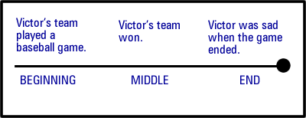
PRACTICE

Slide 6
Social Studies Connection
When studying history, timelines are very useful.
They can show relationships in time between important events.
This allows us to understand WHEN things where occurring.

Slide 7
WARNINING! AD vs. BC
Timelines that explore ancient history are dated BC. We are currently living in AD.
Dates in BC count DOWN (example, 1995 BC happened BEFORE 1990 BC).
Dates in AD count UP (example, 2009 AD happened BEFORE 2010 AD).
WHY? In the Middle Ages, religious historians used the birth of Christ as a central point (year 1 AD) when making the calendar. So….events before count down to the birth and events after count up!

Slide 8
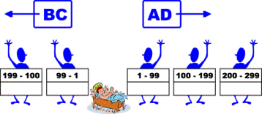
A Visual
Counts DOWN (BC) Counts UP (AD)
199 BC before 99 BC 99 AD before 199 AD

Slide 9
Helpful Hints
BC starts with “B” like before; things that happen before something will count down.
AD starts with “A” like after; things that happened after count up.

Slide 10
Practice
Q: What event happened first in this timeline?
A: The Iroquois join in peace.

Slide 11
Practice
Q: What event happened last in this timeline?
A: Salem begins to trade with other countries.

Slide 12
Practice
Q: What two events happened closest to each other?
A: Jamestown is founded and Salem is founded.

Slide 13
A TWIST
Most commonly, timelines are horizontal, BUT they can also be vertical!
In a horizontal timeline, the event to the LEFT happened first.
In a vertical timeline, the event at the TOP happened first.

Slide 14
Vertical Example
This timeline on the next slide shows how the Pepsi logo has changed, but the Coke one remains the same. The TOP logos happened first (1885 and 1898) leading up to the most recent at the bottom (2010).
Our class schedule (by windows) is a vertical timeline of our day! Morning happened first (top) and afternon after (bottom).

Slide 15
